Slide 1
Presents
\
Erasing Borders: 2017
Festival of Indian Dance
www.iaac.us

Slide 2
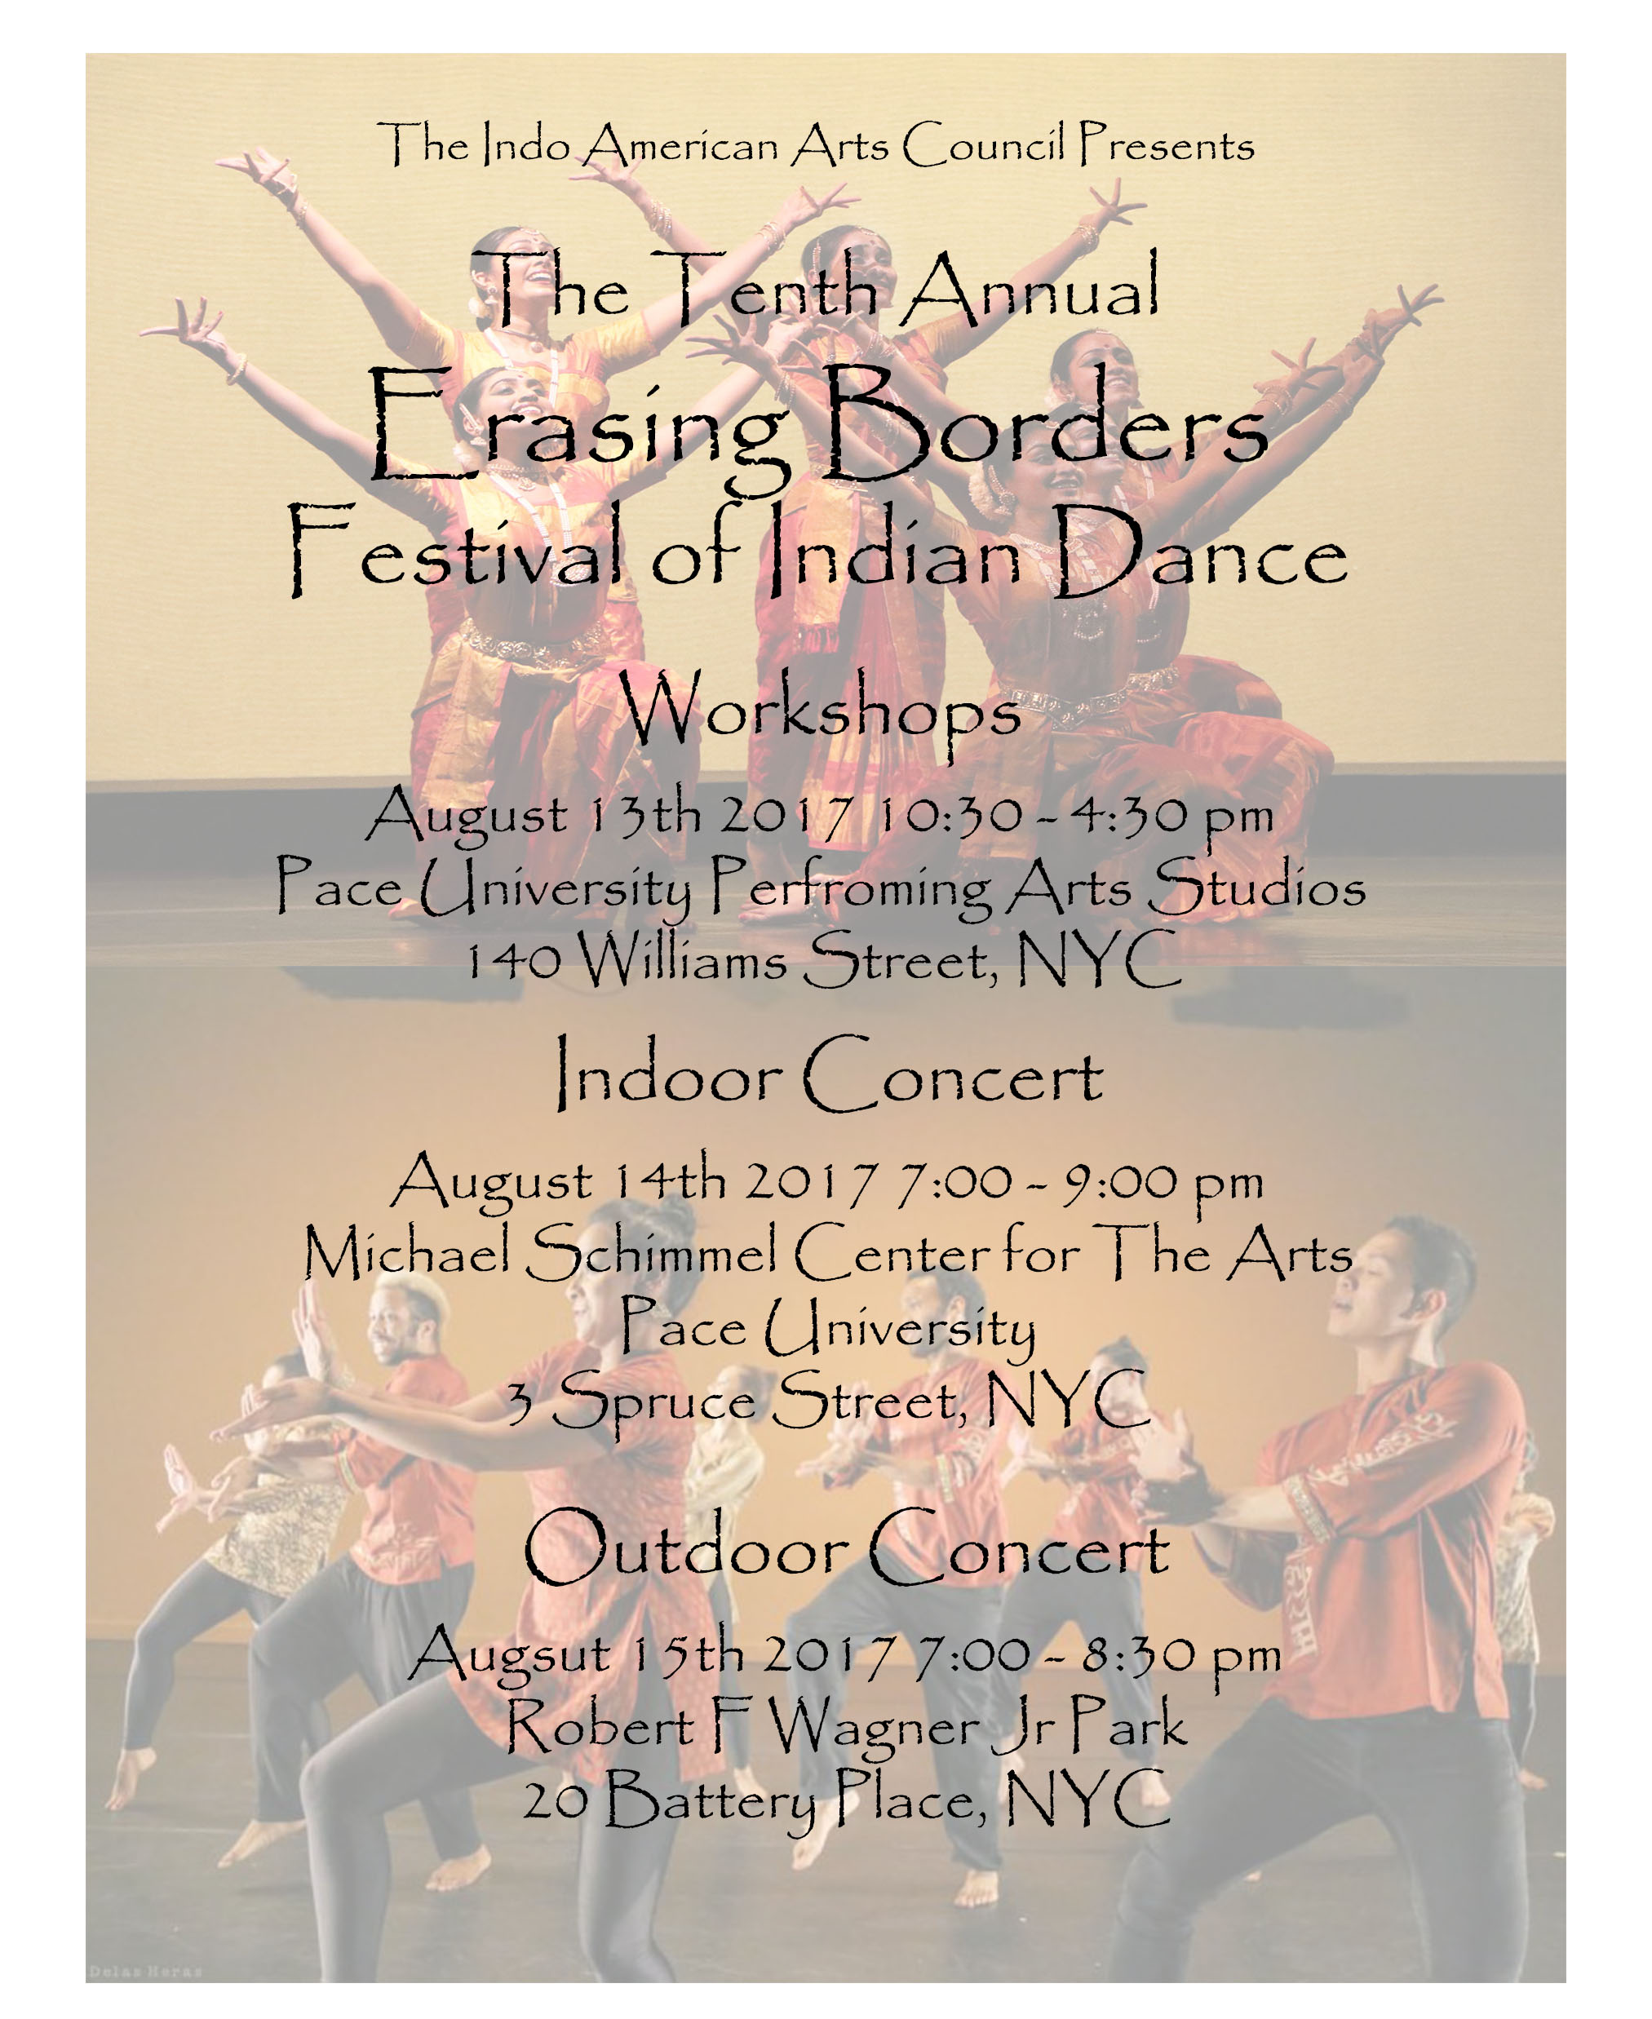

Slide 3
Erasing Borders:
Festival of Indian Dance
Sharing Movement, Heritage, & Inspiration from the Indian Subcontinent.
A premier event that brings to New York Indian and India-inspired dance in an array of forms, old and new: concerts feature performances traditional and experimental, classical and post-modern, folk and popular.
Day sessions of panels, workshops, and demonstrations explore aspects of Indian dance across genres.

Slide 4
Project Vision
Diversity
Cross-Cultural Dialogue
Professional Development
Educational Outreach
Appreciation & Awareness
Sustainable Dance
Audience Development

Slide 5
Audience
Located in the Cultural Capital of the World - New York, NY
Reaches ~2500 people
•Dedicated audience of 2500 over 3 days of the festival
Mailing list of 68,000 elite and arts afficianados
Daily website hits of 2000 during the festival and leading up to it
Typical Audience Profile:
Age group: 16- 65+
Indoor Festival: Elite and sophisticated audience
Outdoor Festival: Mixed audience
Master Classes/Workshops: Dancers, Students, Dance afficianados.
65% of the audience is women
Audience represents all the various ethnicities in New York.

Slide 6
Visibility
DNA India
India Post
Sahara One
ITV
Asiance magazine
The South Asian Insider
narthaki.com
daily.chictoday.com
Asia Pacific Forum
Odissi.blogspot.com
Project Impact
The festival receives excellent media coverage
TV Asia
AVS TV
Bharat Vani TV
News India Times
Desi News
CNN
Lassi with Lavina
New York Times
New York Sun
Wall Street Journal
Star Ledger
India Abroad
Time Out NY
DNA India
India Post
Sahara One
ITV
Asiance magazine
The South Asian Insider
narthaki.com
daily.chictoday.com
Asia Pacific Forum
Odissi.blogspot.com

Slide 7
Festival Programs 2017
Workshops
Evening Concert
Free Evening Performances
in collaboration with Battery Dance Festival

Slide 8
Erasing Borders: Festival of Indian Dance
in collaboration with Battery Dance Festival
This free performance will be presented in collaboration with the Downtown Dance Festival. The Battery Dance Company’s Annual Battery Dance Festival was initiated in 1982 to introduce a wide variety of worthy dance companies of all genres to the large and diverse audiences that gather in lower Manhattan’s public spaces.
The Festival places a strong emphasis on the inclusion of diverse dance styles and a multi- ethnic roster of performers. The Festival reaches an average audience of 2000 per day.

Slide 9
Press & Media Coverage
New York has long had festivals of African and flamenco dance; the dance forms of India are every bit as memorable. For that reason Erasing Borders: Festival of Indian Dance strikes me as the best new arrival on this city’s dance scene in the last two years. Individual performances here have often shown various aspects of this area, but the Borders festival affords a survey of its range, while honoring both traditional forms and modern developments. –Alastair Macaulay, NY Times
August might be a quiet month for New York dance lovers, but it brings one of the most satisfying events of the year: the summer performances of the Erasing Borders Festival of Indian Dance, presented by the Indo-American Arts Council.
–dancetabs.com
What makes it marvellous isn't necessarily the quality of the dance (the event is an anthology of Indian styles) or the authenticity of its delivery (most of the music is taped and considerably amplified) but its sheer incongruity.The event's other great virtue is its diversity of styles deriving from different geographical regions.
- NY Times
While some Asian dance has been presented in the past at the Asia Society, it is "Erasing Borders" that unites us in greater dimension and artistic achievement.
-Marian Horosko, www.exploredance.com
Erasing Borders will forever change the way you view dance. Like the ballerinas of the past and the lucky audiences who have already experienced the first free performance at One Chase Manhattan Plaza on Monday afternoon, you will find yourself awed by the beauty of this cultural exchange and what a skip across several colorful borders can provide. -E. Nina Rothe, Anjabee
The festival exhibited a magnificent melange of styles and traditions. The educational component of the festival explored the complexities of aesthetics, sensibilities, issues and perspectives of the rich tradition of Indian dance, while at the same time nurturing exciting new dimensions developing in the Indian, American and global contexts.
-Joseph Aranha, South Asian Insider

Slide 10
Sponsor Opportunity
IAAC partners with select organizations whose objectives align with those of the Dance Festival thereby engaging and nurturing long-term mutually beneficial relationships
As the festival continues to grow, it becomes an increasingly formidable marketing platform for partners and organizations to garner targeted exposure
Provides access to the Indian Diaspora in the East Coast market
Opportunity for an International brand to establish and entrench itself amongst US consumers Targeted marketing to specific income, occupation and gender based groups
Recognition for involvement and support in developing the arts and culture of NYC

Slide 11
Past Sponsors/ Partners (Cash & In-Kind)

Slide 12
Sponsorship and Branding
Marketing benefits associated with the festival include:
Effective brand development and visibility
Showcases social and community responsibility
On-site corporate hospitality and benefits
Media exposure
Signage
Promotional presence on website and collateral materials
Networking opportunities with celebrities
Right to promote / co-brand

Slide 13
Sponsorship Levels
Sponsorship levels range from $5,000 - $300,000. Details on specific benefits can be provided upon request. Sponsorship packages may be tailored to specific sponsor requirements.
Diamond Sponsorship - $200,000
Sapphire Sponsorship - $150,000
Ruby Sponsorship - $100,00
Pearl Sponsorship - $75,000
Gold Sponsorship - $50,000
Silver Sponsorship - $25,000

Slide 14
Ruby Sponsor (Associate Sponsor)
Advertisement
Prime placement of Advertisement in Festival Brochure
Brand Visibility
Priority Placement of Logo in Print, Television and Online Marketing
Exclusive Product Placement at the Evening Concert and Receptions Priority Placement of Banner at evening concert venues
Placement of Banner at outdoor performance venue Distribution of Promotional material at Dance Festival
Invitation & tickets
Opening and Closing Receptions, and all dance events
6 VIP tickets for Evening Performances of Dance Festival
Felicitation
Opportunity to speak at Reception for Dance Festival
Special thanks and acknowledgement from the podium for dance events
Sponsorship Value: $75,000

Slide 15
Sapphire Sponsor (Presenting Sponsor)
Advertisement
Back Inside Cover Advertisement in Festival Brochure
Brand Visibility
Priority Placement of Logo in Print, Television and Online Marketing
Exclusive Product Placement at the Receptions
Priority Placement of Banner at evening concert venues Priority Placement of Banner at outdoor performance venue Placement in Festival press release as partner
Distribution of Promotional material at Dance Festival
Invitation & tickets
Opening and Closing Receptions and all dance events
10 VIP tickets for Evening Performances of Dance Festival
Felicitation
Opportunity to speak at Reception and Press Conference for Festival
Special thanks and acknowledgement from the podium for dance events
Sponsorship Value: $100,000

Slide 16
Diamond Sponsor (Title Sponsor)
The Festival will be named after the Diamond Sponsor for a minimum of 3 years and can be renewed.
Advertisement
Back Inside Cover Advertisement in Festival Brochure
Brand Visibility
Priority Placement of Logo in Print, Television and Online Marketing
Exclusive Product Placement at the Receptions
Priority Placement of Banner at evening concert venues Priority Placement of Banner at outdoor performance venue Placement in Festival press release as partner
Distribution of Promotional material at Dance Festival
Invitation & tickets
Opening and Closing Receptions and all dance events
10 VIP tickets for Evening Performances of Dance Festival
Felicitation
Opportunity to speak at Reception and Press Conference for Festival
Special thanks and acknowledgement from the podium for dance events
Sponsorship Value: $300,000 for 3 years

Slide 17
IAAC Mission
The Indo-American Arts Council is a registered 501 ©3 not-for-profit, secular service and resource arts organization charged with the mission of promoting and building the awareness, creation, production, exhibition, publication and performance of Indian and cross-cultural art forms in North America. The IAAC supports all artistic disciplines in the classical, fusion, folk and innovative forms influenced by the arts of India. We work cooperatively with colleagues around the United States to broaden our collective audiences and create a network for shared information, resources and funding. Our focus is to work with artists and arts organizations in North America as well as to facilitate artists and arts organizations from India to exhibit, perform and produce their works here.

Slide 18
Board of Directors
Talat Ansari, Legal Counsel
Aroon Shivdasani, President & Executive Director
Jonathan Hollander Vice President & Co-­‐Founder
Prakash Shah Ambassador
James Luce
Suresh Venkatachari Chairman, 8K Miles Media
Talat Ansari Sr. Partner, Kelly Drye & Warren. Legal Counsel.
IAAC Staff
Aroon Shivdasani, Artistic & Executive Director
Deepsikha Chatterjee, Director, Dance Festival
Aseem Chhabra, Director, Film Festival
Anjali Maniam, Director, Development
Rohan Gupta, Theatre Director
Vasanti Mirchandani, Director, Hospitality
lmrana Khera, Grant Writer
Ramneek Kang, Special Events Manager
Shaurya Chawla, Madiline Dean, Joseph Savior, Interns
Dominique Legros, Dance Intern
Advisory Board
*Dilip Advani *Veena Advani *Shabana Azmi *Robert Browning *Gerson da Cunha *Uma da Cunha *Mahesh Dattani *Vishakha Desai *Wynn Handman *(late) Maqbool Fida Hussain *Ustad Amjad Ali Khan *Deepa Mehta *Nari Pohani *Rajika Puri *Zeyba Rahman *Indr Shivdasani *Sundaram Tagore*Shashi Tharoor *Madhur Jaffrey *Mira Nair *Salman Rushdie *Dr. Murali Doriaswamy *Jane Gullong*Mallika Sarabhai *Ambassador Neelam Deo *Tino Puri *Chandrika Tandon *Yakub Mathew*Priyanka Mathew *Dr. Sunil Kothari *Javed Akhtar *(late) Ismail Merchant *Dinyar Devitre
*James Gara *Dr. Manjula Bansal *Sree Sreenivasan

Slide 19
Dance Festival Goals and Objectives
Provide a platform for emerging dancers
Highlight new works of established artists
Reach diverse audiences
Develop appreciation for Indian dance
Provide a platform for choreography with high standards of artistic excellence.
Provide a forum for interaction and dialogue between dancers, dance scholars, writers and critics.
Provide a forum for exchange between Indian and non-Indian dancers and choreographers.
Develop credibility for the Indian performing art forms within the broader performing arts community.

Slide 20
Dance Festival Committee
Aroon Shivdasani
Executive and Artistic Director, IAAC
Jonathan Hollander
Artistic Director, Battery Dance Co
Barry Steele
Production Designer, Battery Dance Co.
Deepsikha Chatterjee
Dance Festival Director
Rajika Puri
Chief Curator, Dancer, Actress, Writer and Critic
Uttara Coorlawala
Co-Curator, Dance Scholar, Writer and Critic
Suman Madhuri
Marketing & Publicity
Parul Shah
Curatorial Advisor , Dancer
Michael Collins
Producer
Vasanti Mirchandani
Hospitality Director
Indo-American Arts Council
517 East 87th St, Suite 1B, New York, NY 10128.
Phone: 212 594 3685
Website: www.iaac.us, E-mail: iaac.dance@gmail.com
Dominique Legros
Dance Intern

Slide 21
Erasing Borders:
Festival of Indian Dance
August 13- 15, 2017

